Slide 1

Cybersecurity in the Banking Sector & Fintech
Khalid Damrah
Information Security Risk Manager

Slide 2
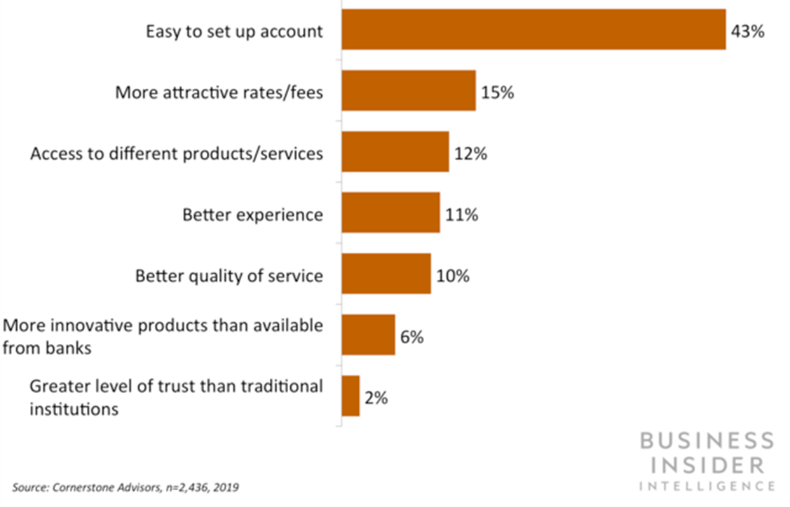
Top Reasons Consumers Adopt Fintech Solutions

Slide 3
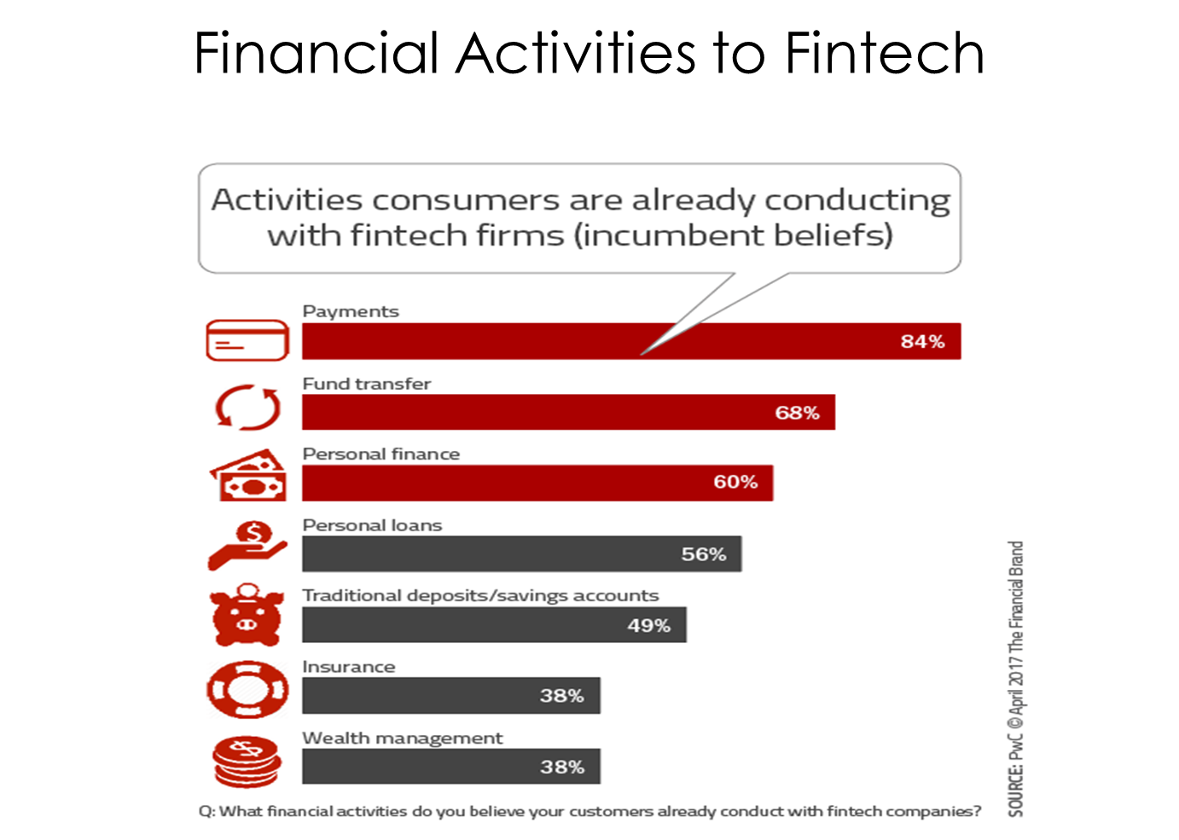

Slide 4
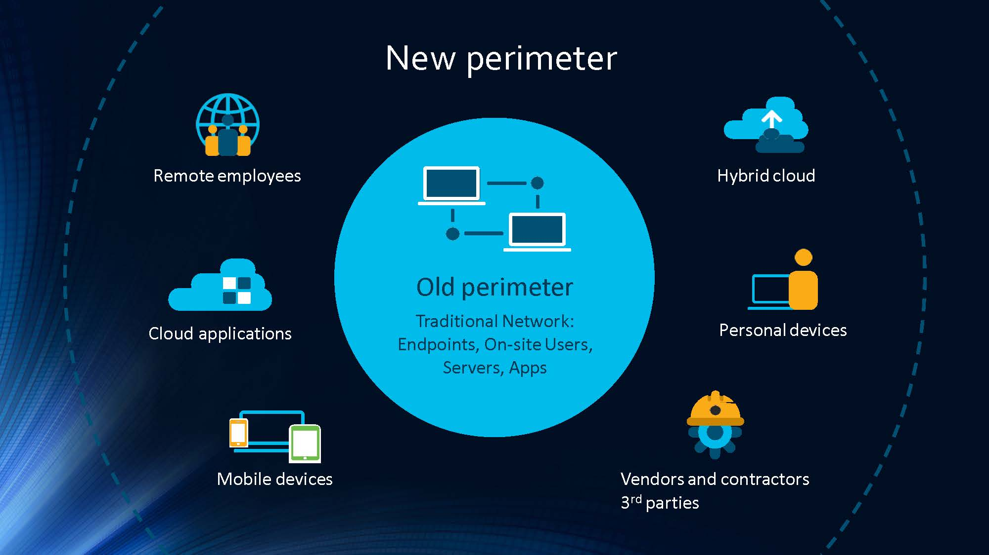

Slide 5
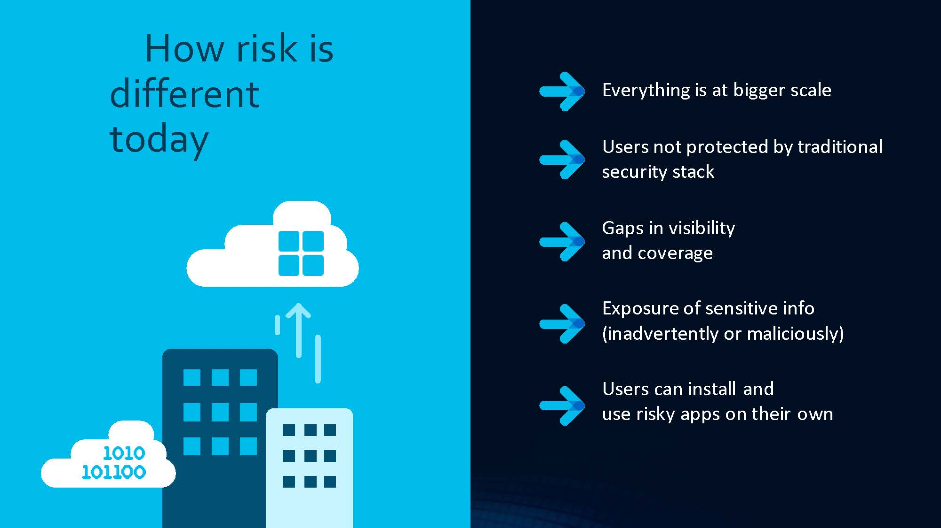

Slide 6
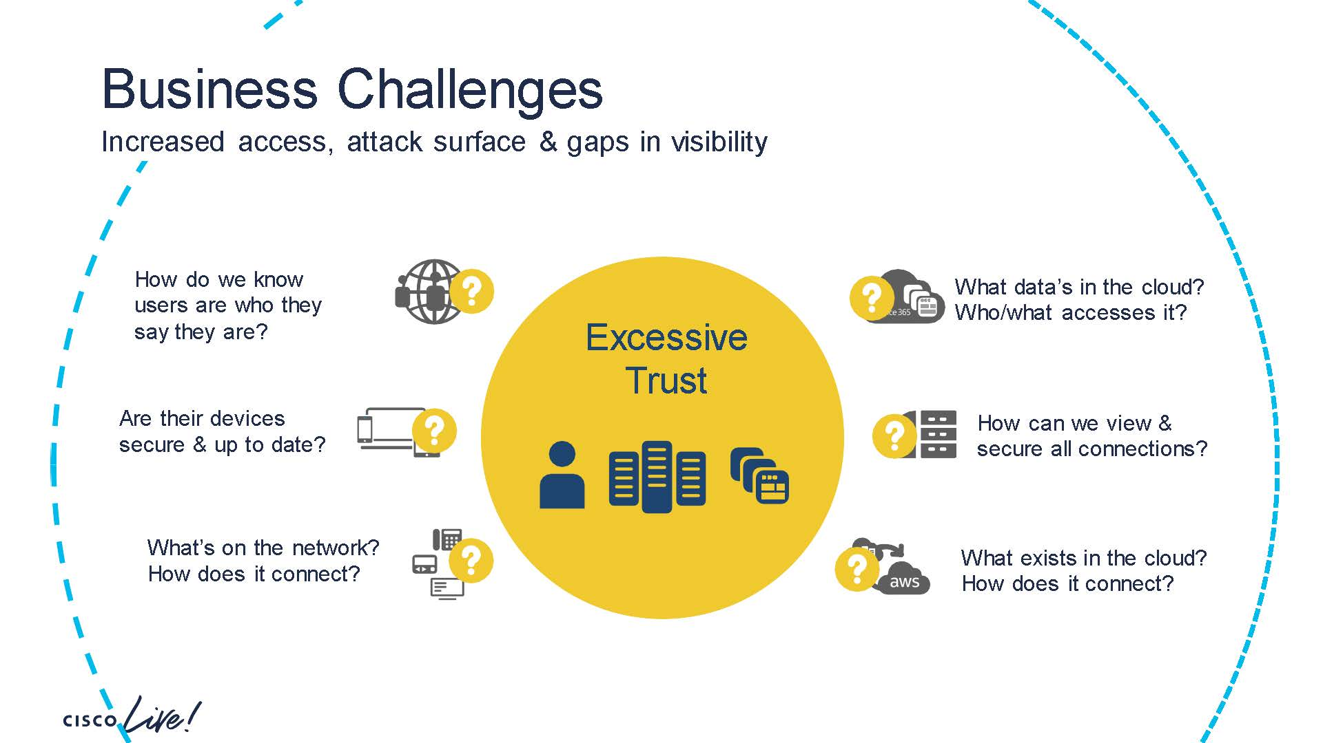


Slide 7
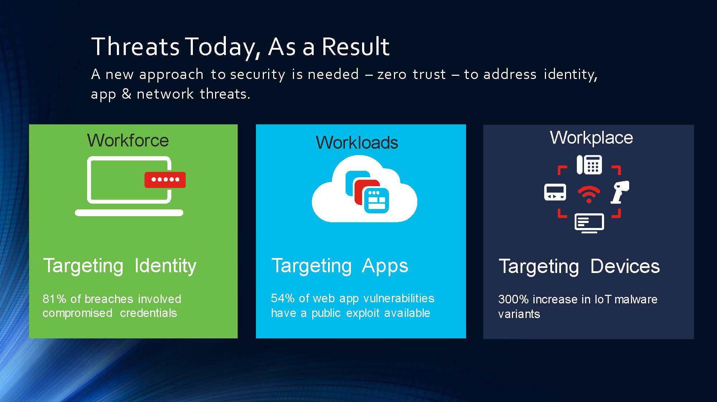

Slide 8
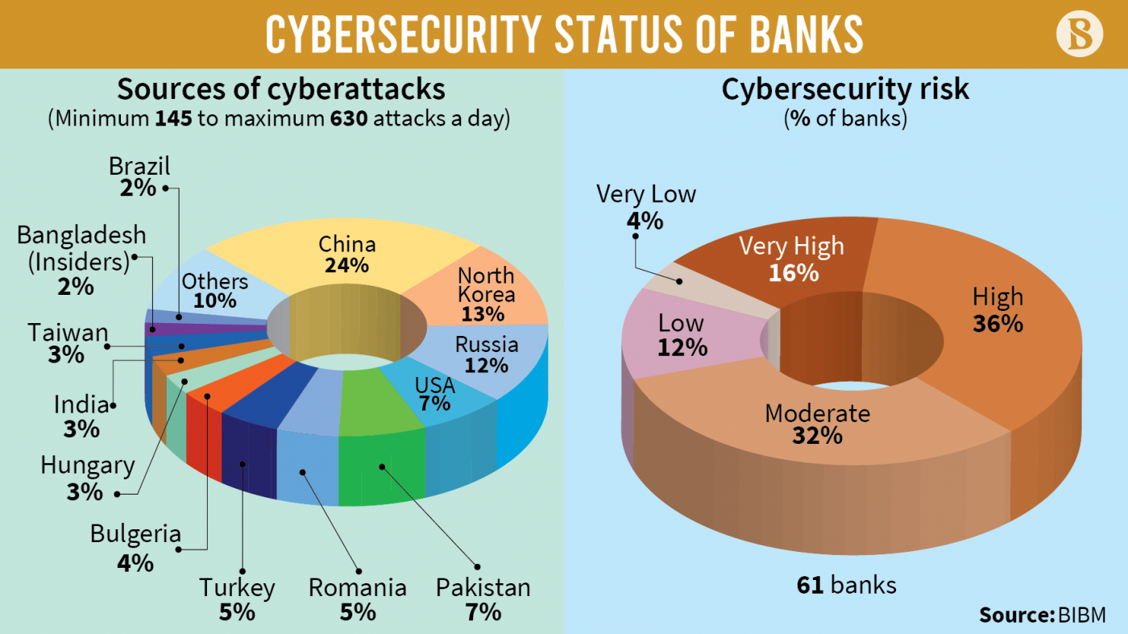

Slide 9
